Slide 1
Chapter 2 Configuration Space
Chapter 3 Rigid-Body Motions
Chapter 4 Forward Kinematics
Chapter 5 Velocity Kinematics and Statics
5.1 Manipulator Jacobian
Chapter 6 Inverse Kinematics
Chapter 7 Kinematics of Closed Chains
Chapter 8 Dynamics of Open Chains
Chapter 9 Trajectory Generation
Chapter 10 Motion Planning
Chapter 11 Robot Control
Chapter 12 Grasping and Manipulation
Chapter 13 Wheeled Mobile Robots

Slide 2
Important concepts, symbols, and equations
“Geometric” forward kinematics
𝜃(t) ∈ ℝ^{n}, X(t) = T_{sb}(𝜃(t)) ∈ SE(3) via PoE
“Minimum coordinate” forward kinematics
𝜃(t) ∈ ℝ^{n}, x(t) = f (𝜃(t)) ∈ ℝ^{m}
(x₁, x₂)

Slide 3
Important concepts, symbols, and equations (cont.)
}
(coordinate)
Jacobian
$\dot{x}$ = [ J₁(𝜃) J₂(𝜃) ] [ $\dot{θ1}$ $\dot{ θ2}$ ]^{T} = J₁(𝜃) $\dot{θ}$₁ + J₂(𝜃) $\dot{θ}$₂
Column i is the end-effector velocity when $\dot{θ}$_{i} = 1.

Slide 4
Important concepts, symbols, and equations (cont.)
manipulability
ellipsoids
mapping joint velocity limits to end-effector velocity limits

Slide 5
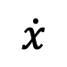

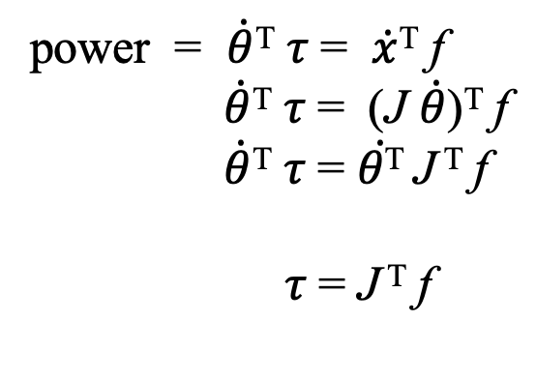

Important concepts, symbols, and equations (cont.)
$$\dot{x}$$
f
, 𝜏₂
power = $\dot{θ}$^{T} 𝜏 = $\dot{x}$^{T} f
$\dot{θ}$^{T} 𝜏 = (J $\dot{θ}$)^{T} f
$\dot{θ}$^{T} 𝜏 = $\dot{θ\text{T}}$J ^{T} f
𝜏 = J ^{T} f
, 𝜏₁
if J is
invertible

Slide 6
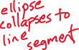
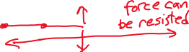
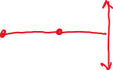
Important concepts, symbols, and equations (cont.)
A configuration 𝜃 is singular if J(𝜃) loses rank.
e-e motion capability becomes zero in one or more directions
e-e can resist infinite force in one or more directions
force
motion
approaching a singularity...

Slide 7

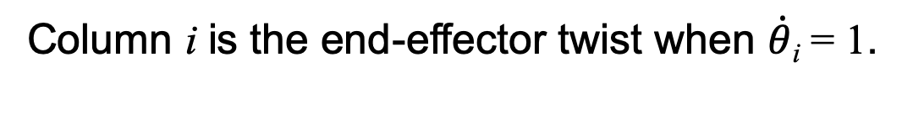

Important concepts, symbols, and equations (cont.)
Space Jacobian
Body Jacobian
{
where
i = 2, ..., n
{
i = 1, ..., n − 1
where
Column i is the end-effector twist when $\dot{θ}$_{i} = 1.

Slide 8
